Slide 1


Slide 2
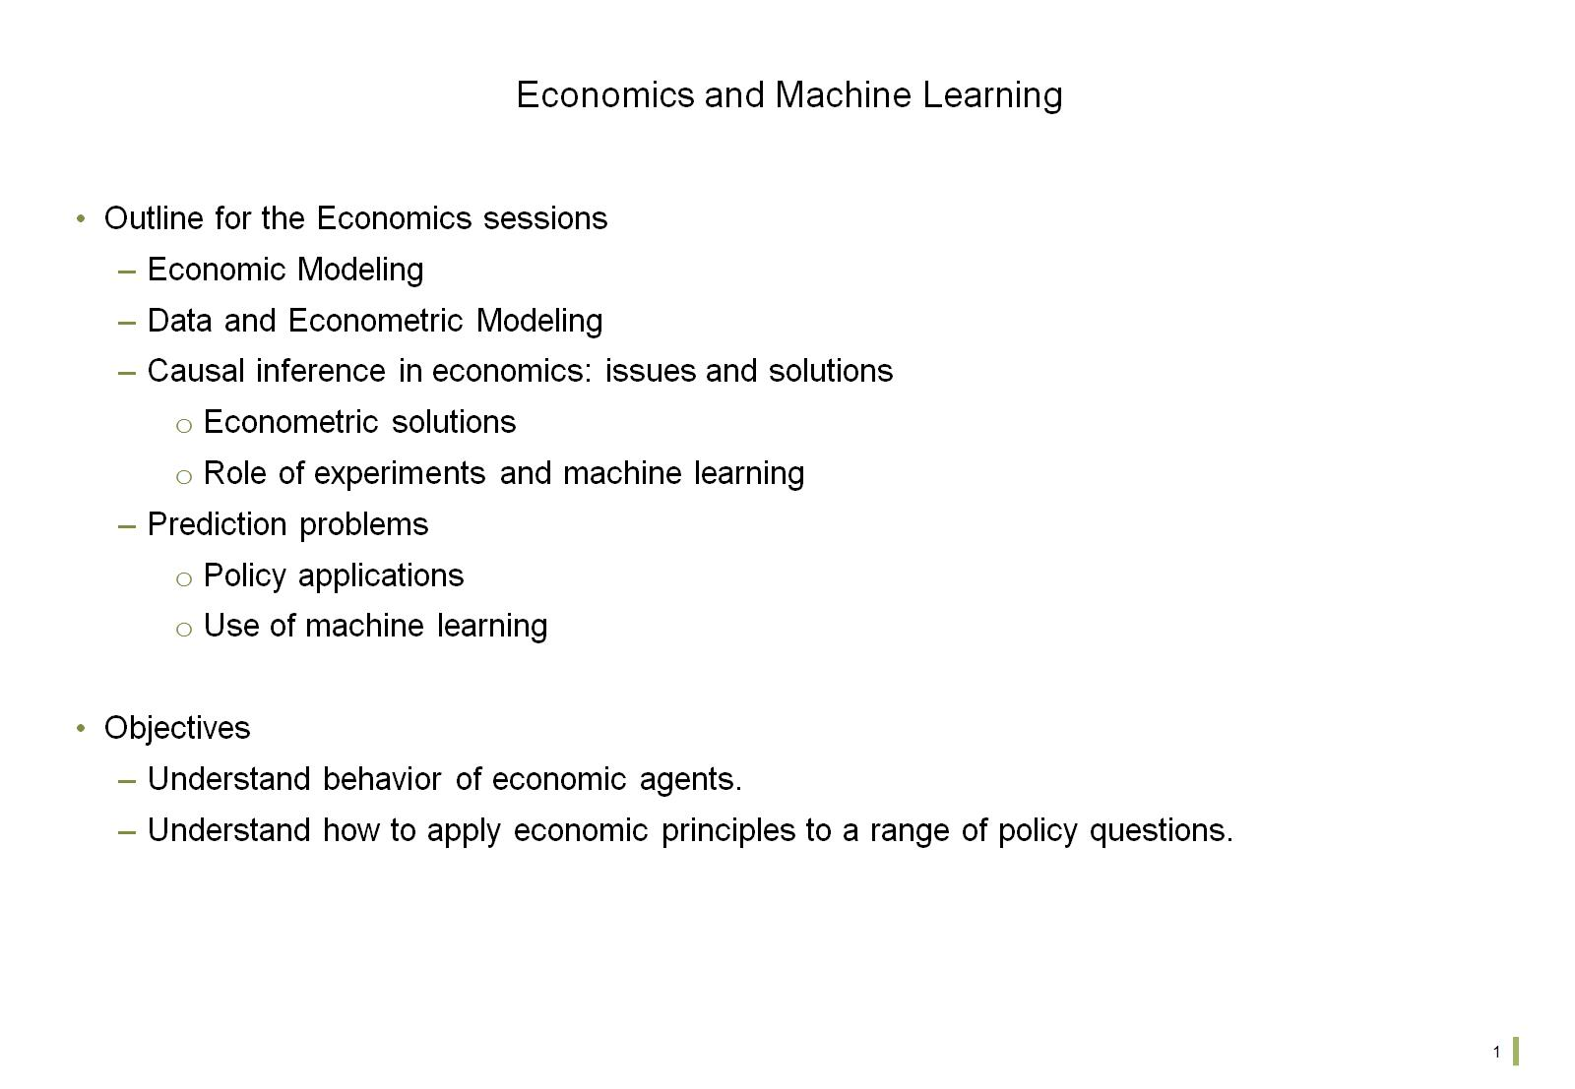
Economics and Machine Learning

Slide 3
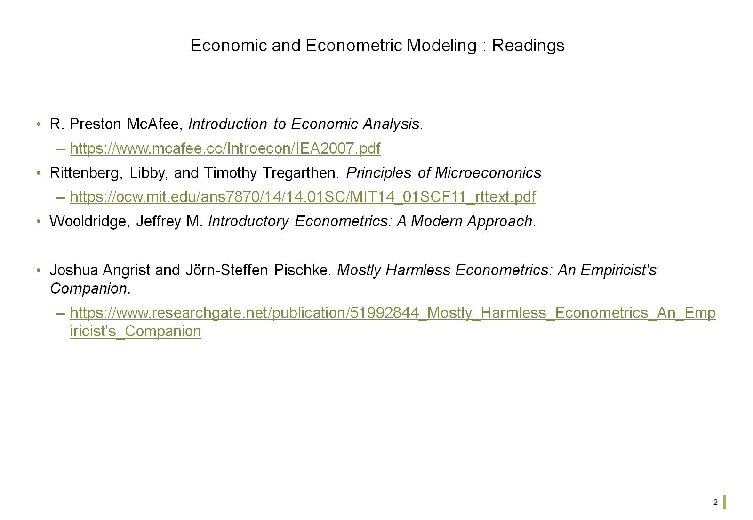
Economic and Econometric Modeling : Readings

Slide 4
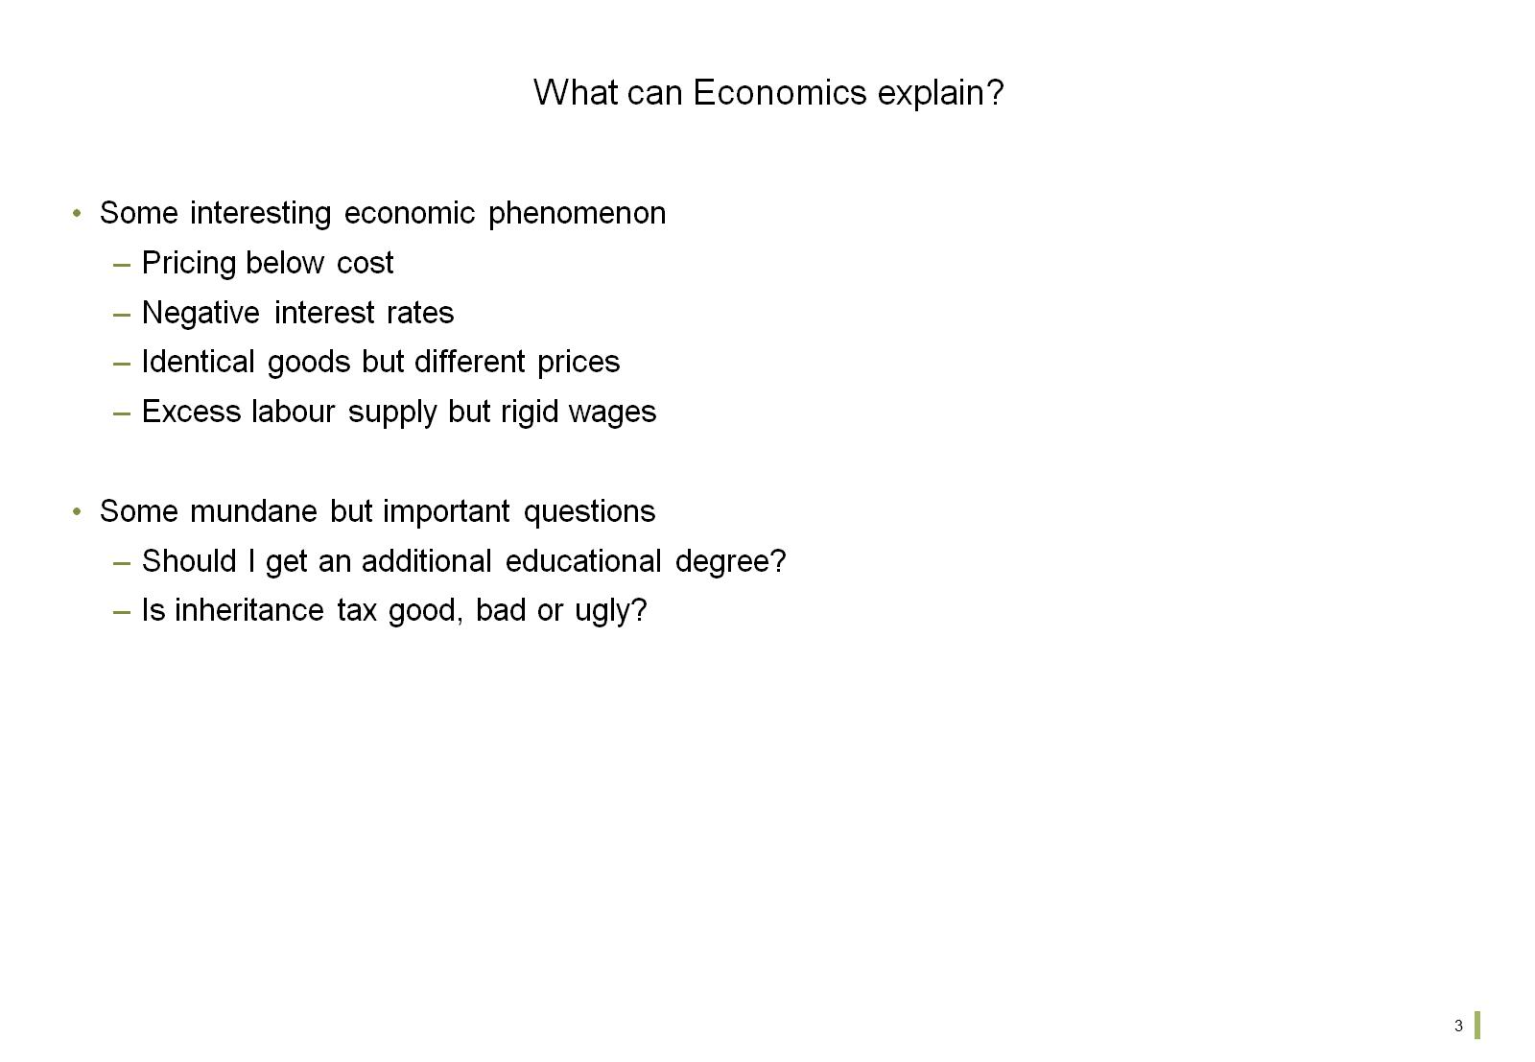
What can Economics explain?

Slide 5
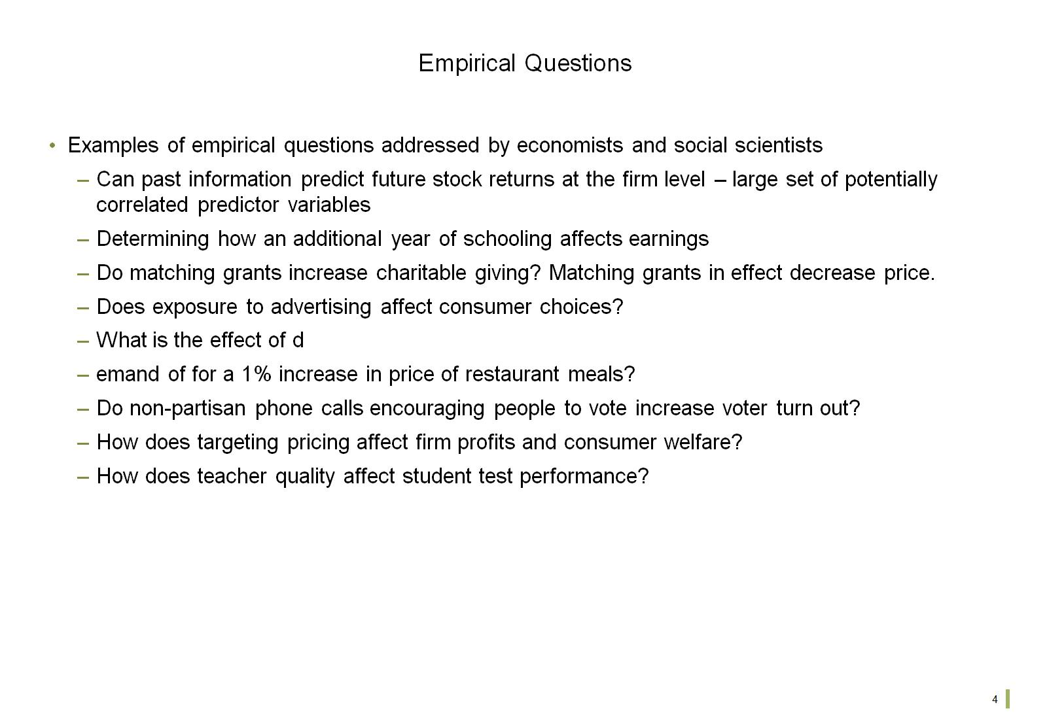
Empirical Questions

Slide 6
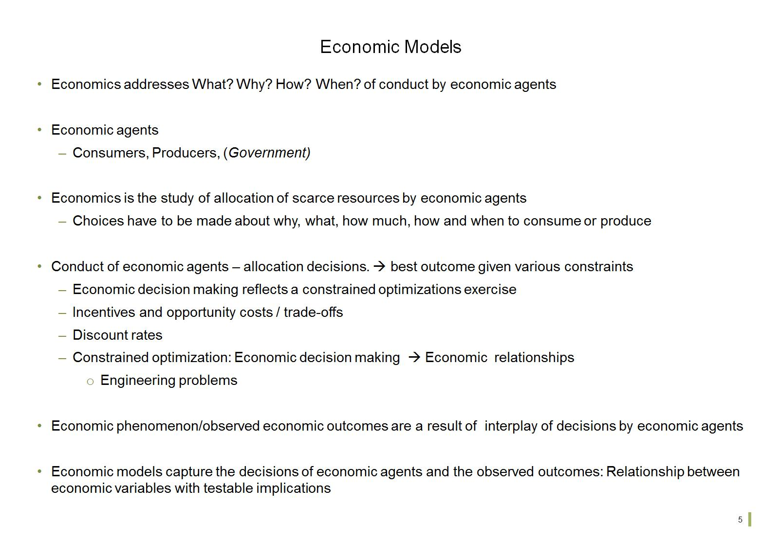
Economic Models

Slide 7
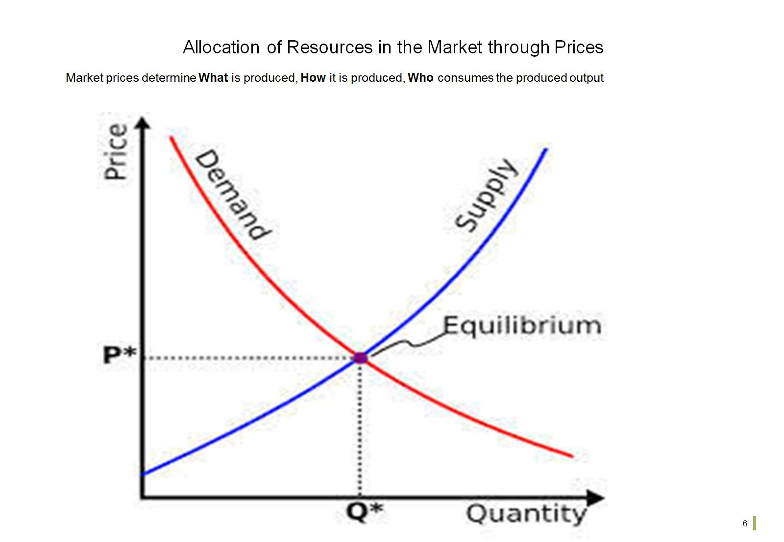
Allocation of Resources in the Market through Prices

Slide 8
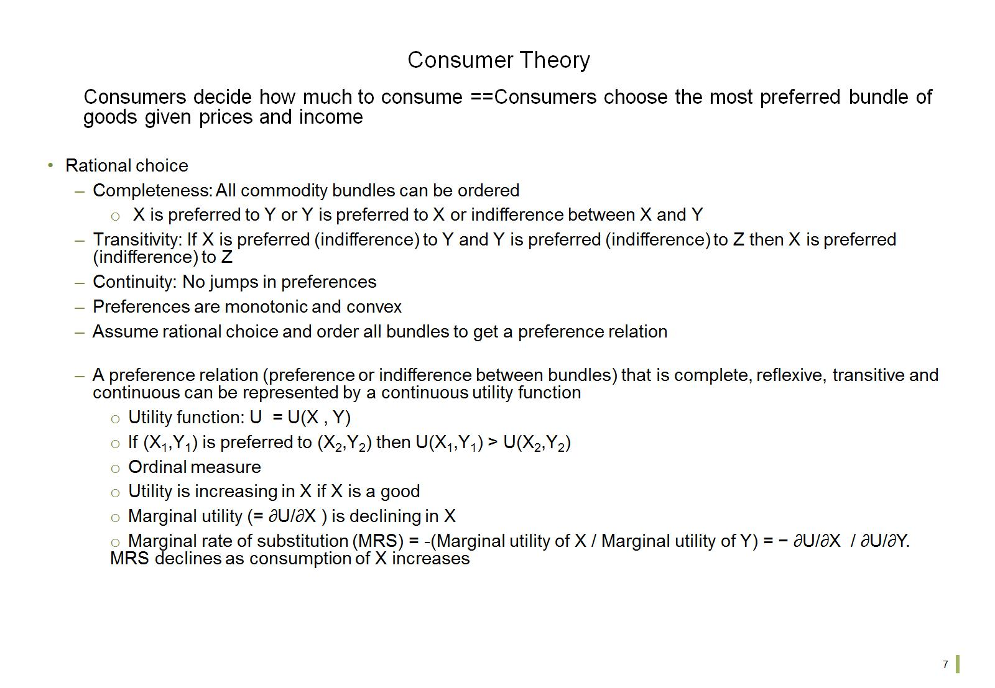
Consumer Theory

Slide 9
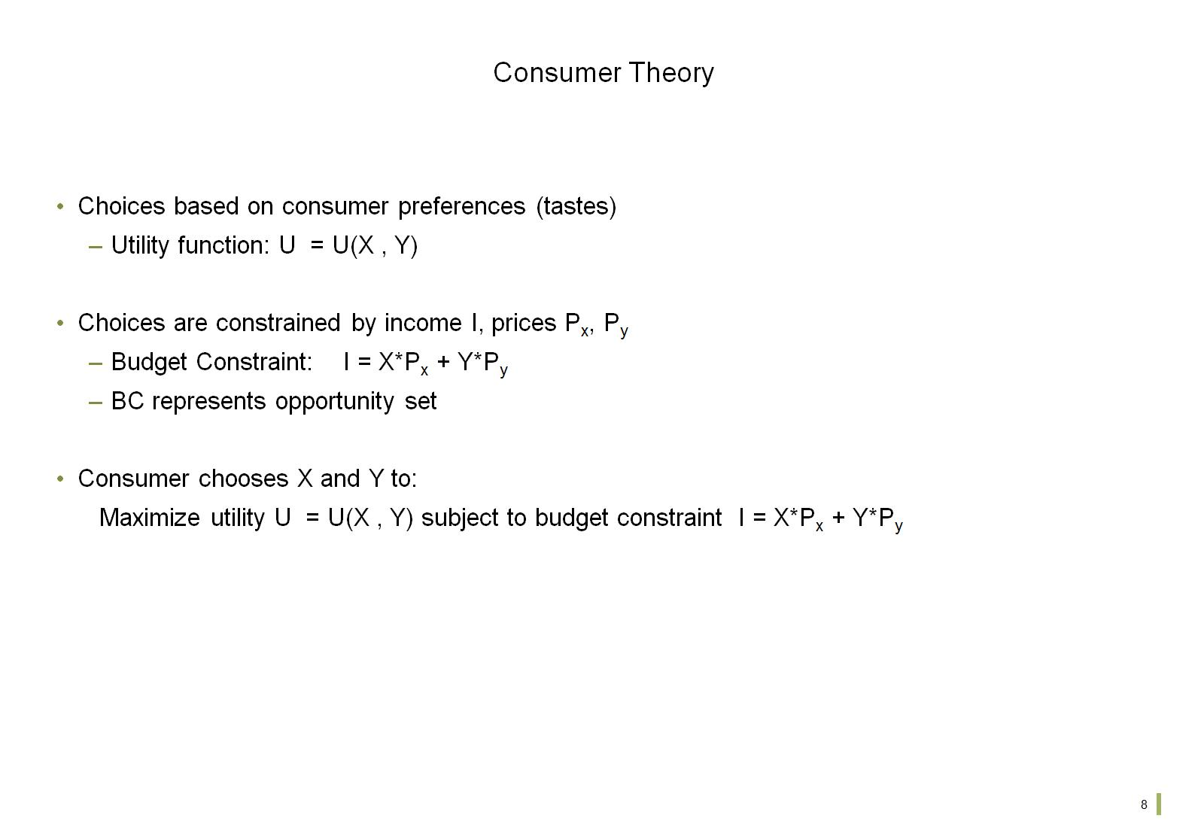
Consumer Theory

Slide 10
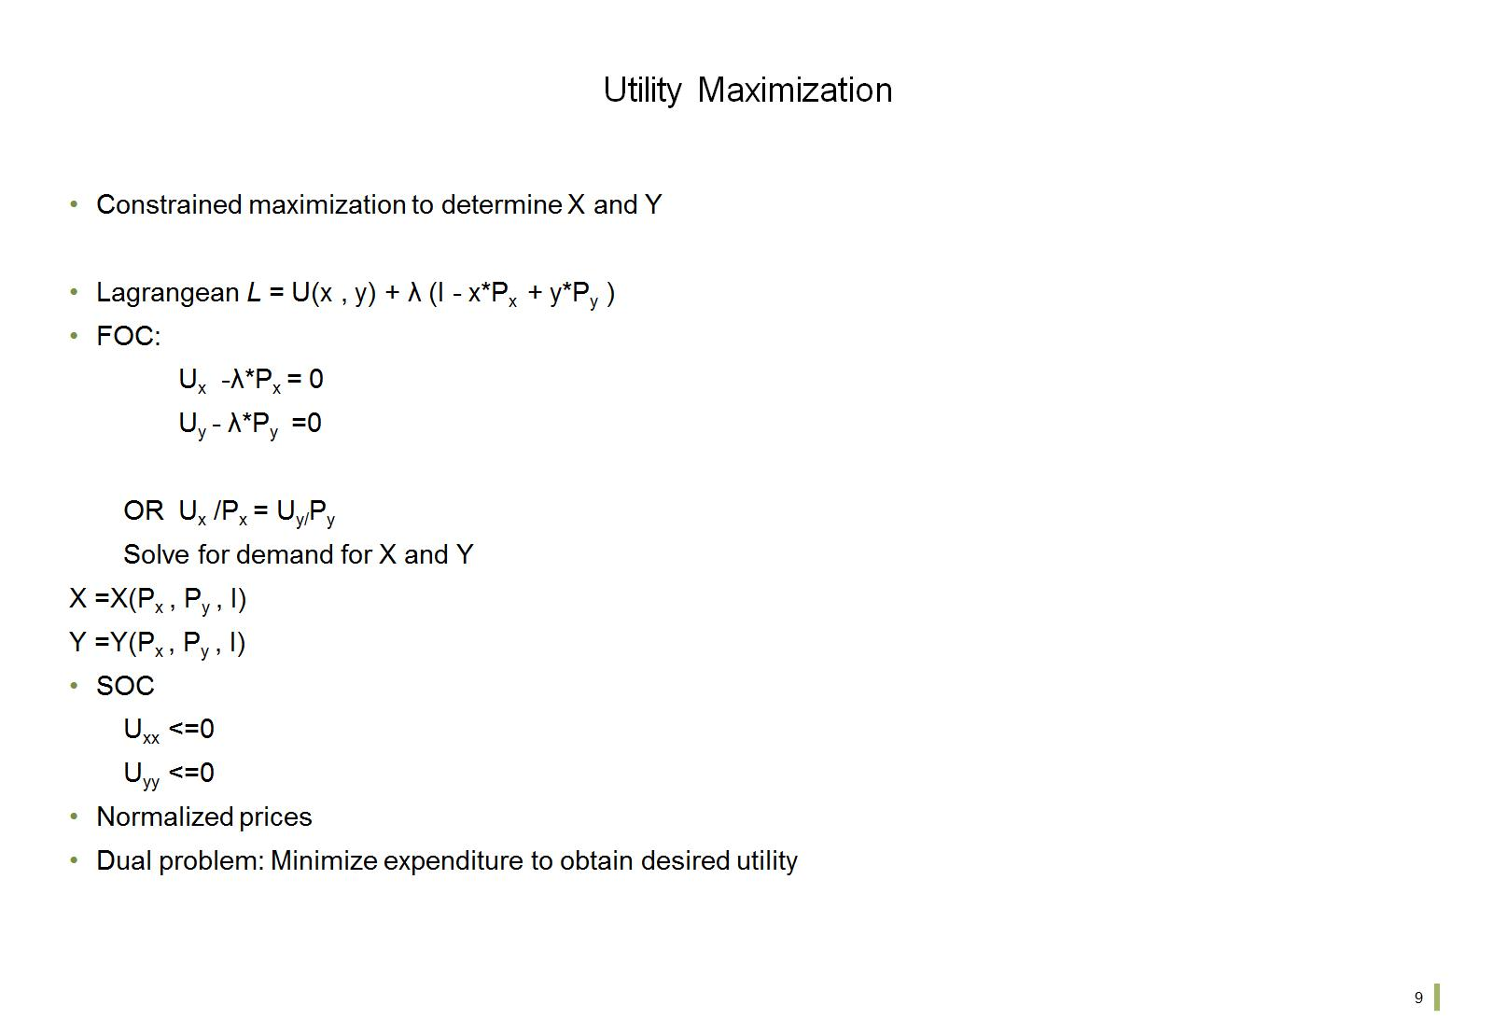
Utility Maximization

Slide 11
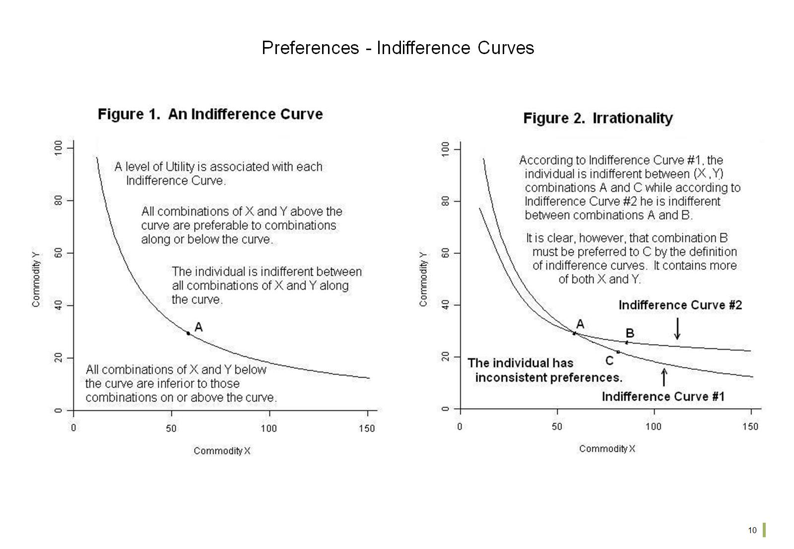
Preferences - Indifference Curves

Slide 12
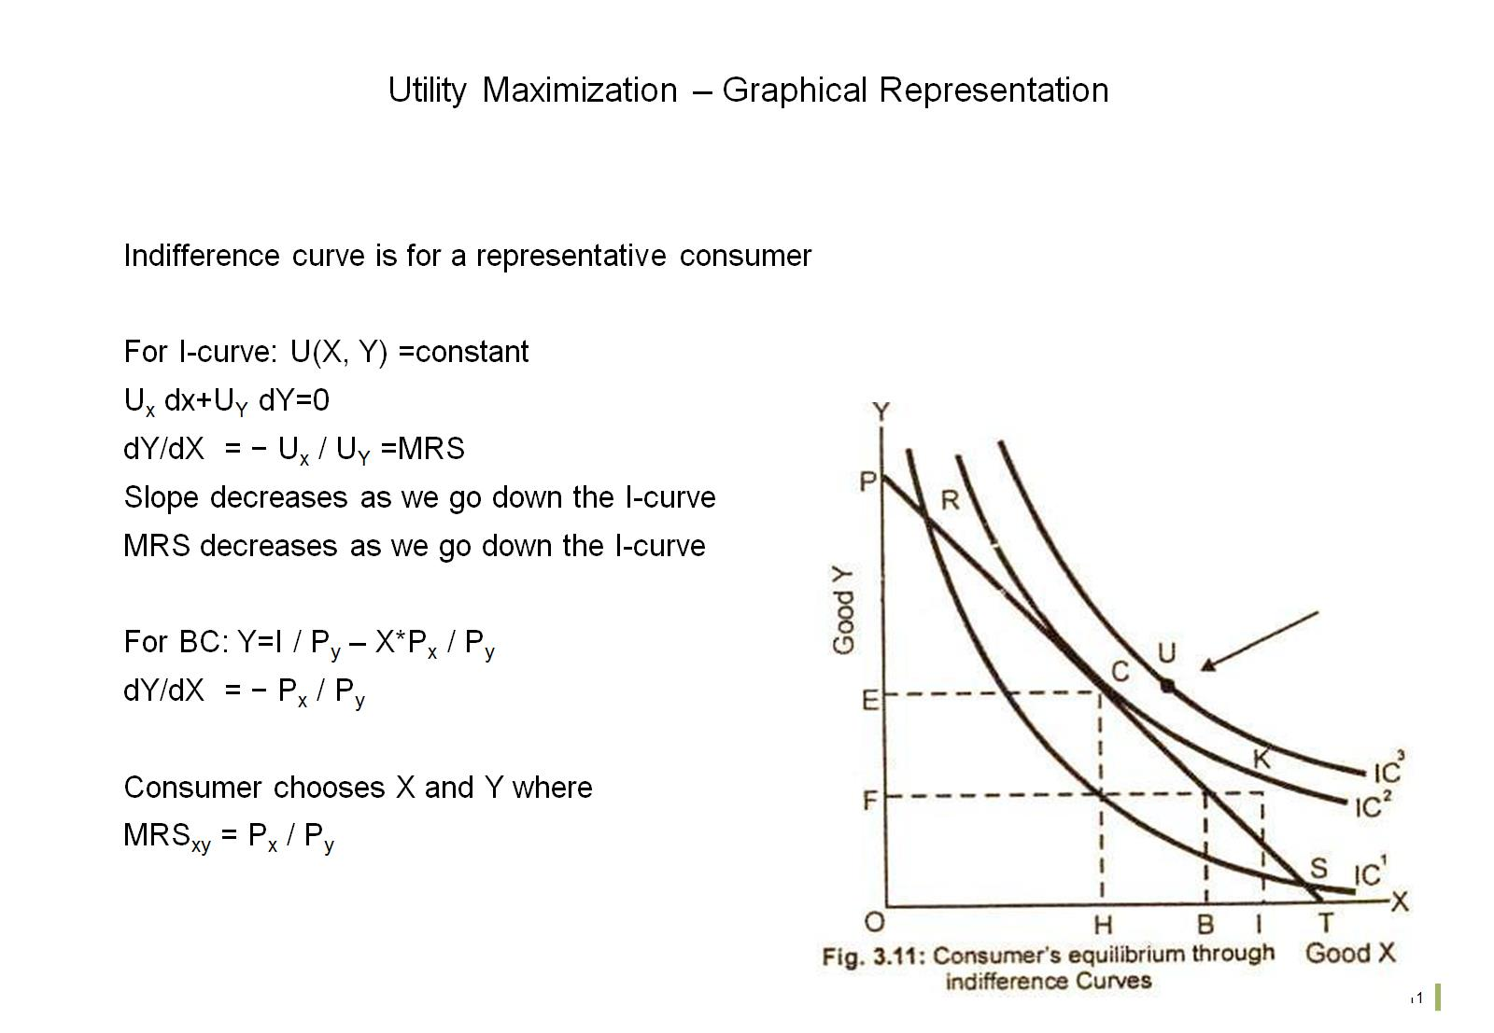
Utility Maximization – Graphical Representation

Slide 13
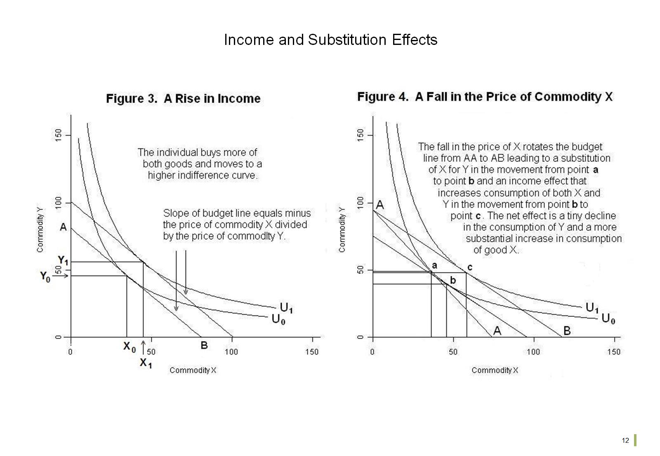
Income and Substitution Effects

Slide 14
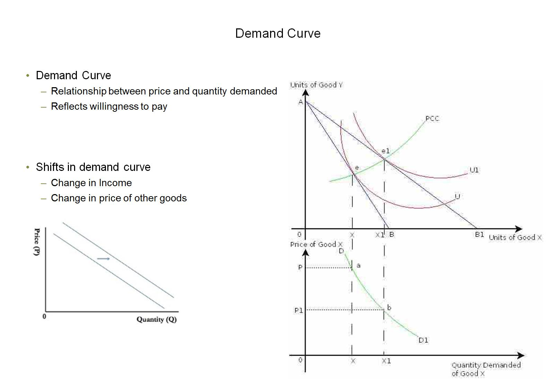
Demand Curve

Slide 15
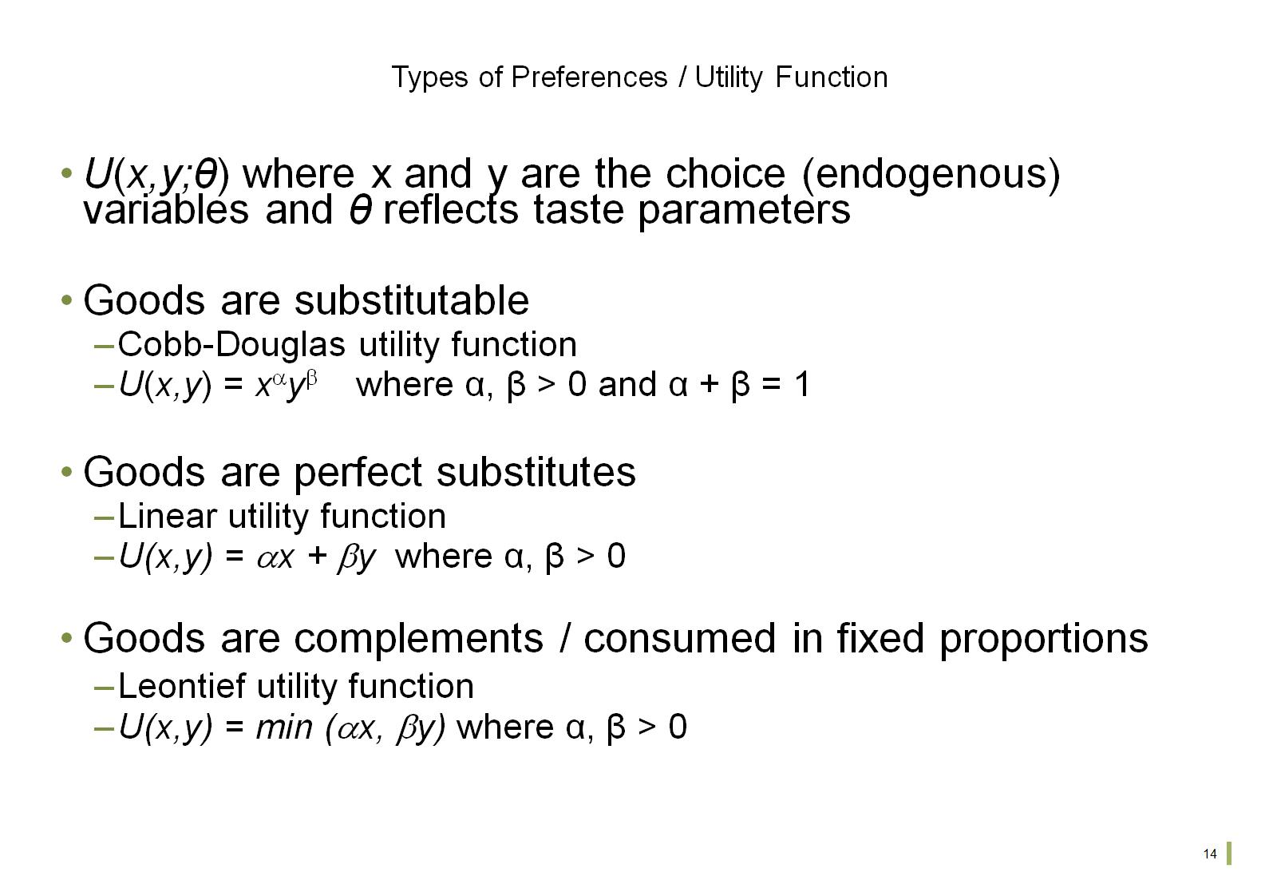
Types of Preferences / Utility Function

Slide 16
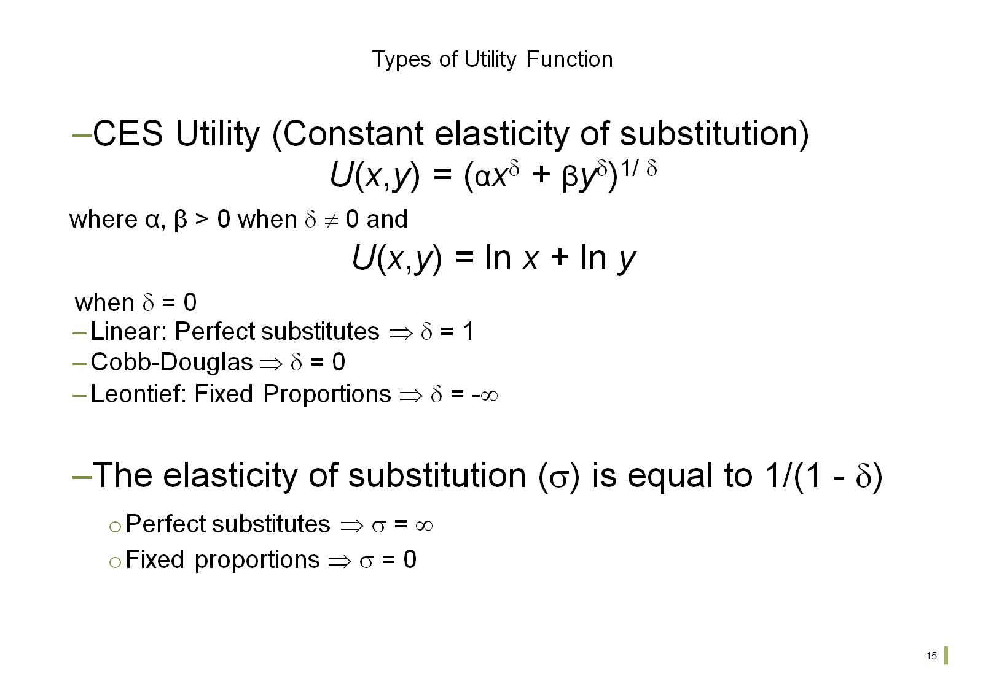
Types of Utility Function

Slide 17
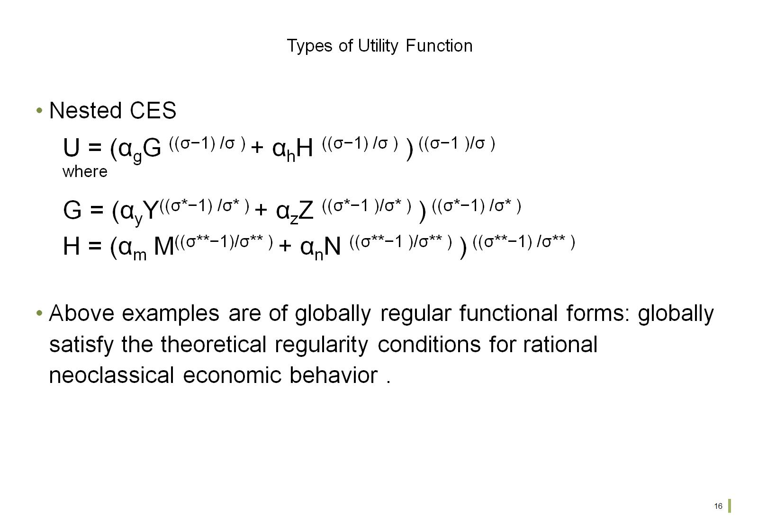
Types of Utility Function

Slide 18
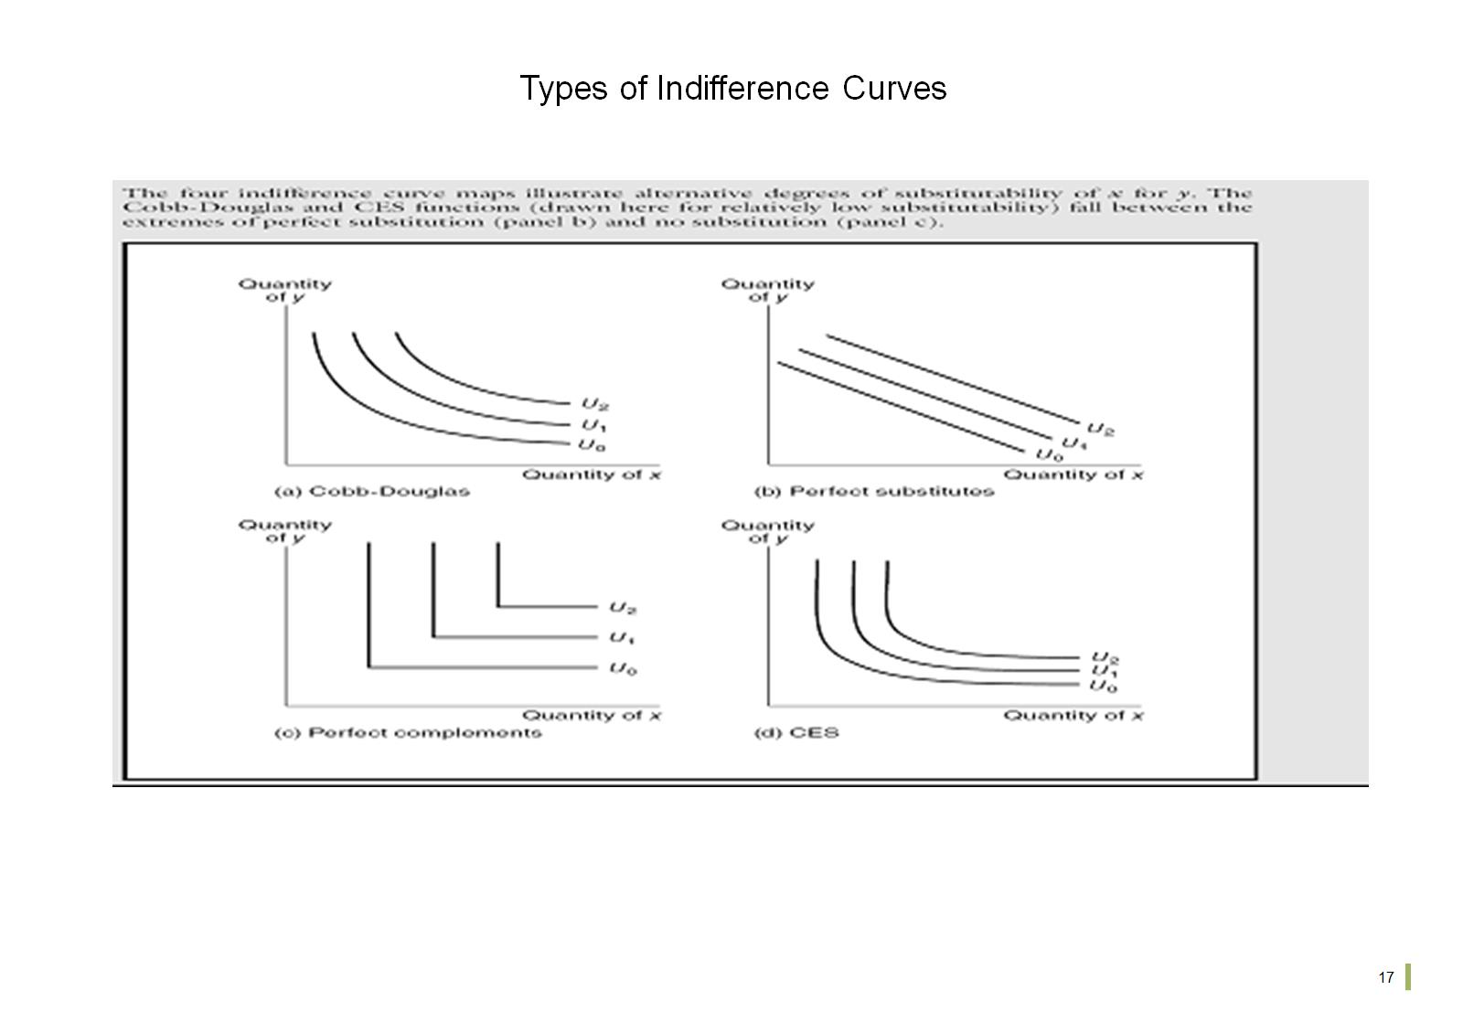
Types of Indifference Curves

Slide 19
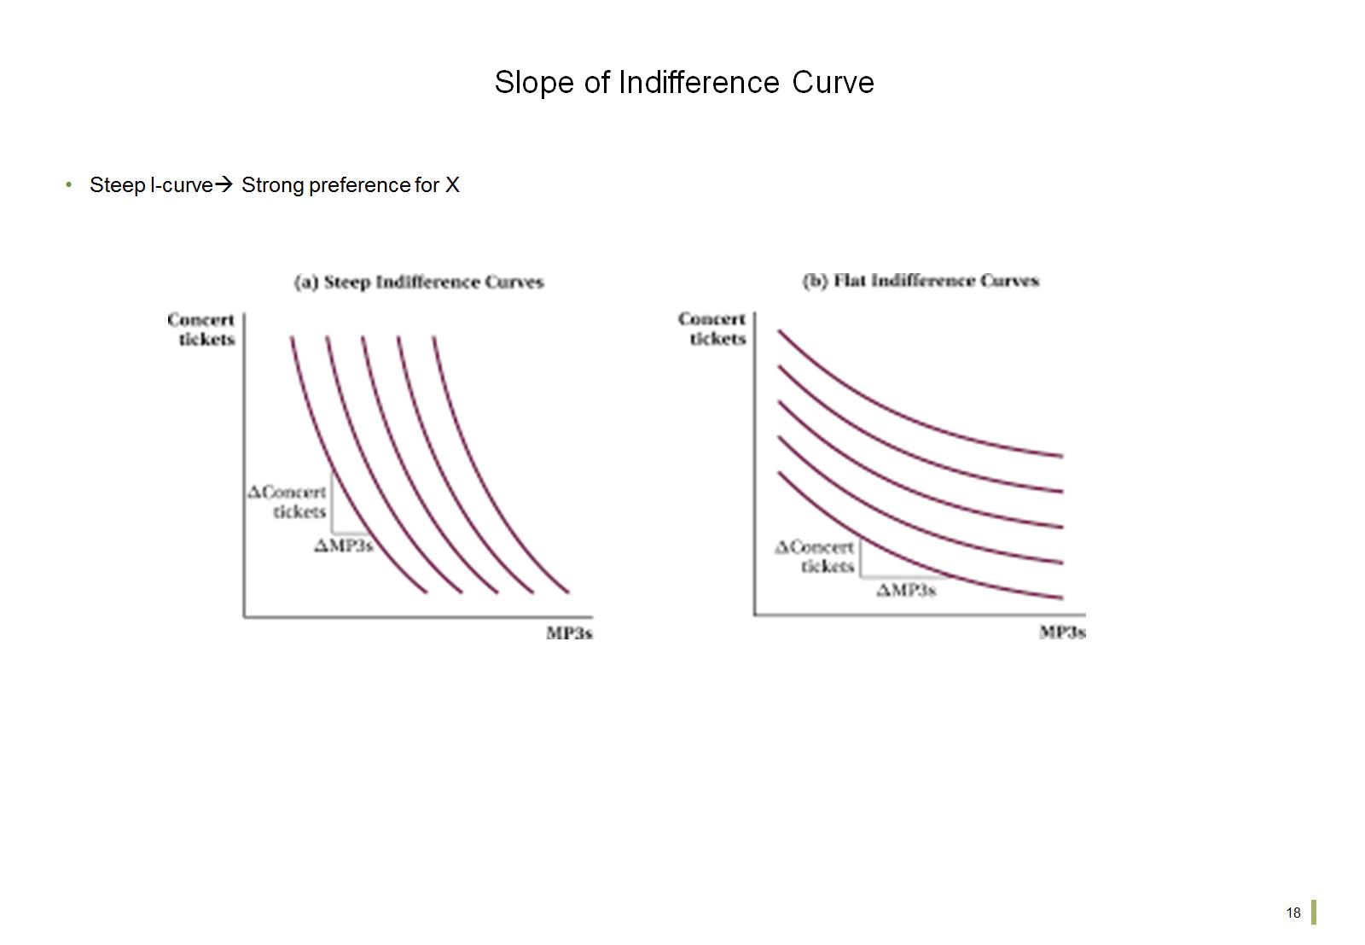
Slope of Indifference Curve

Slide 20
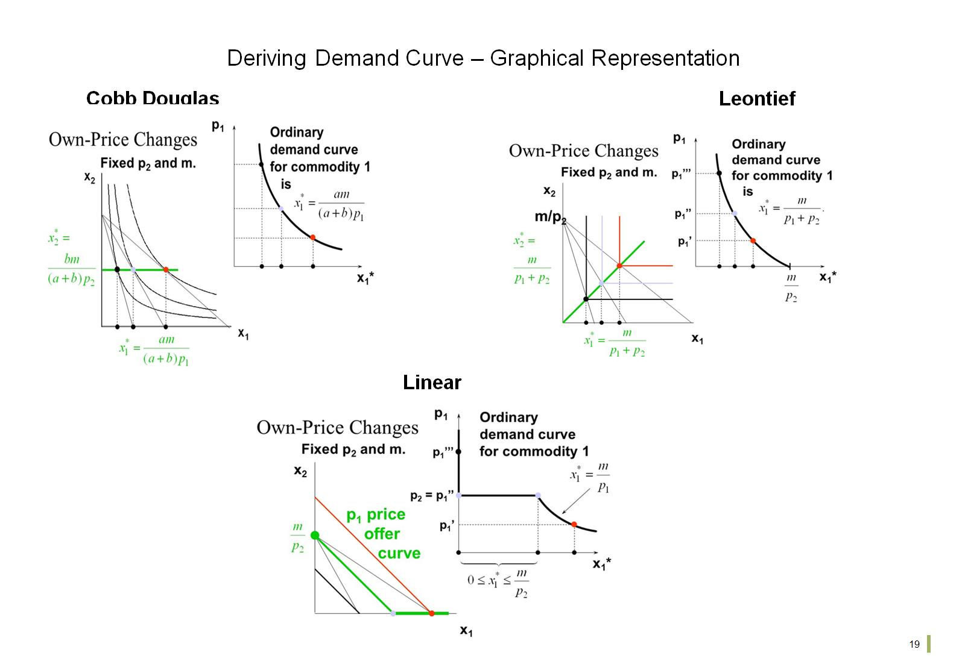
Deriving Demand Curve – Graphical Representation

Slide 21
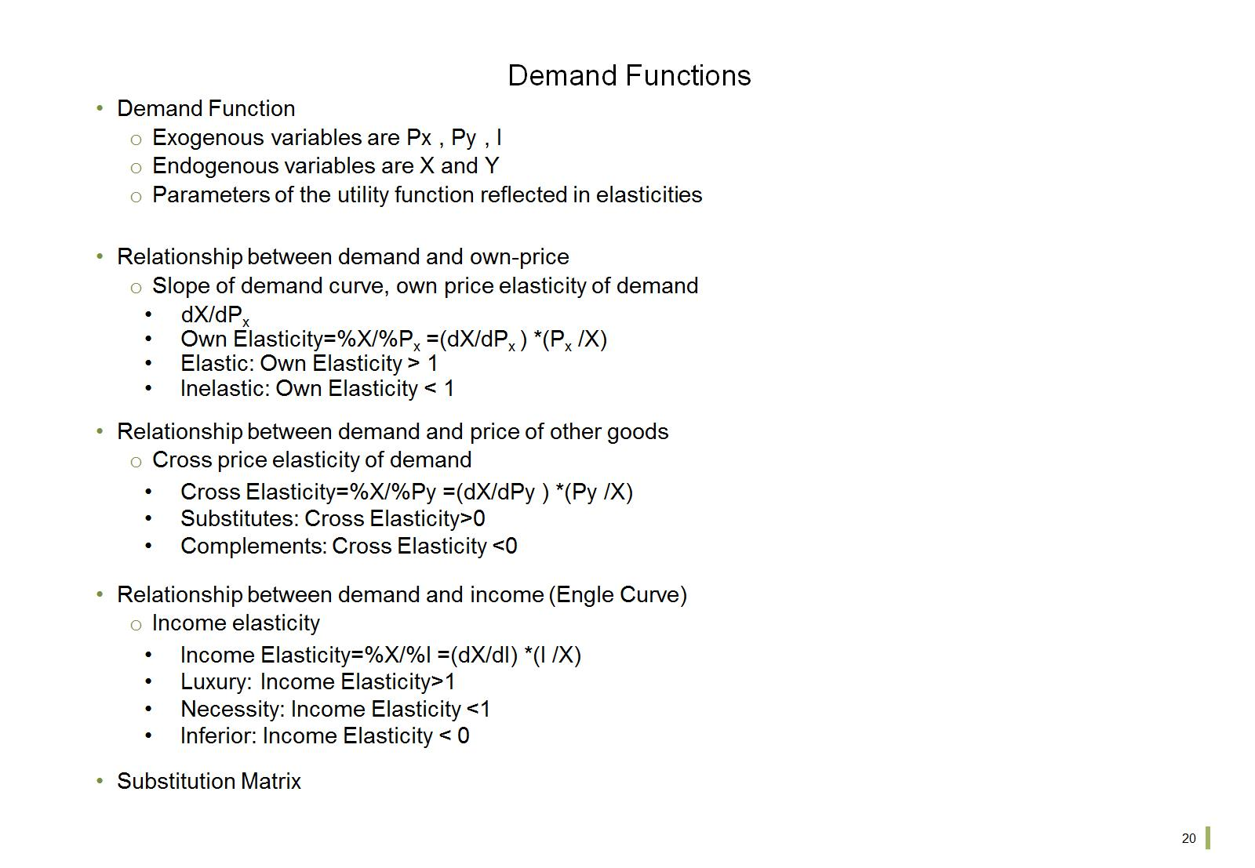
Demand Functions

Slide 22
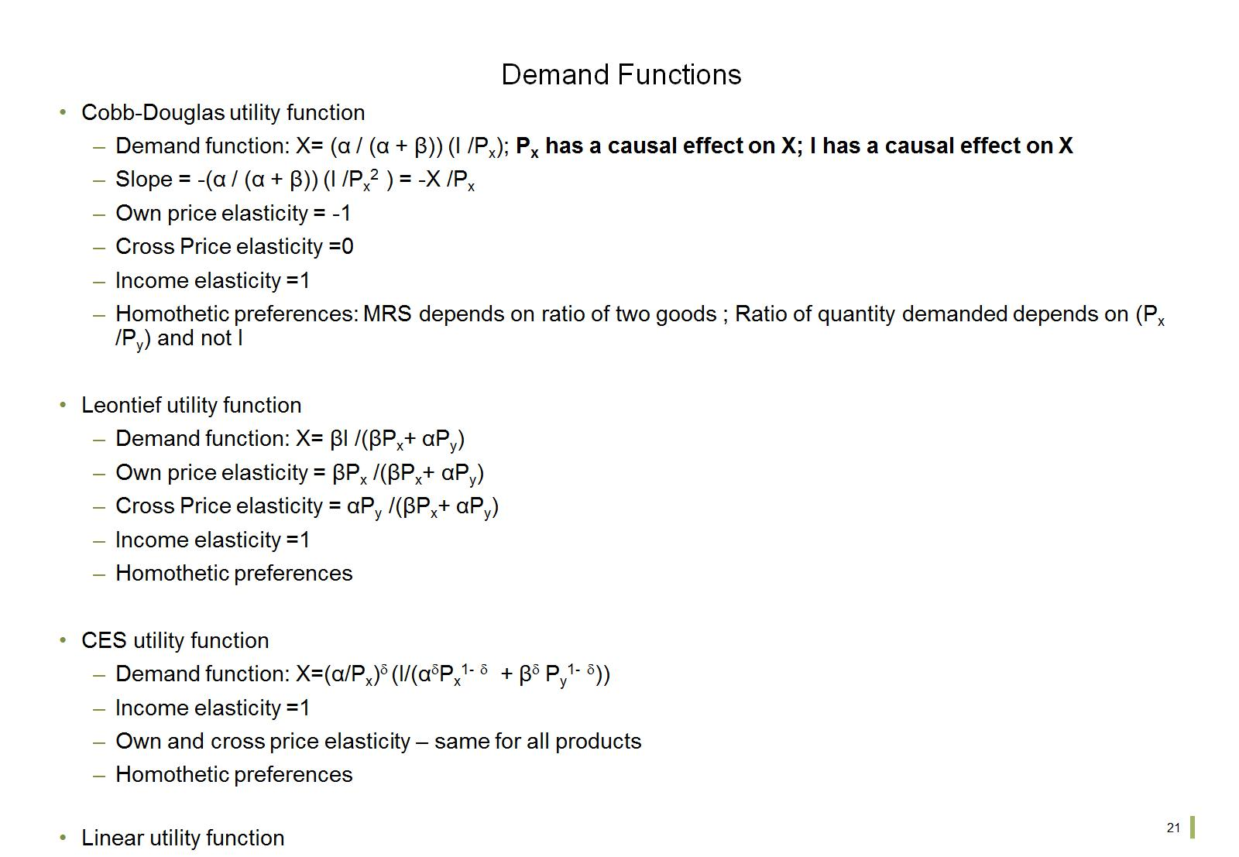
Demand Functions

Slide 23
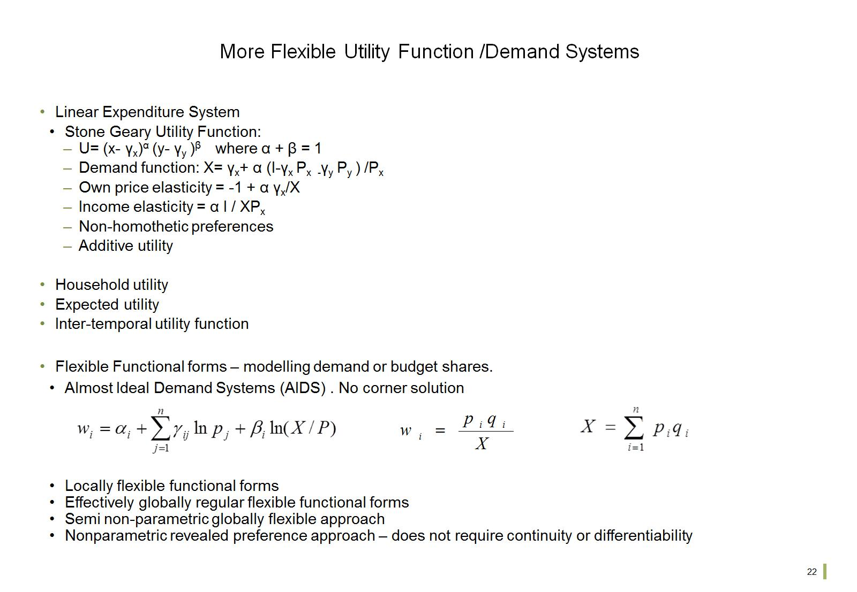
More Flexible Utility Function /Demand Systems

Slide 24
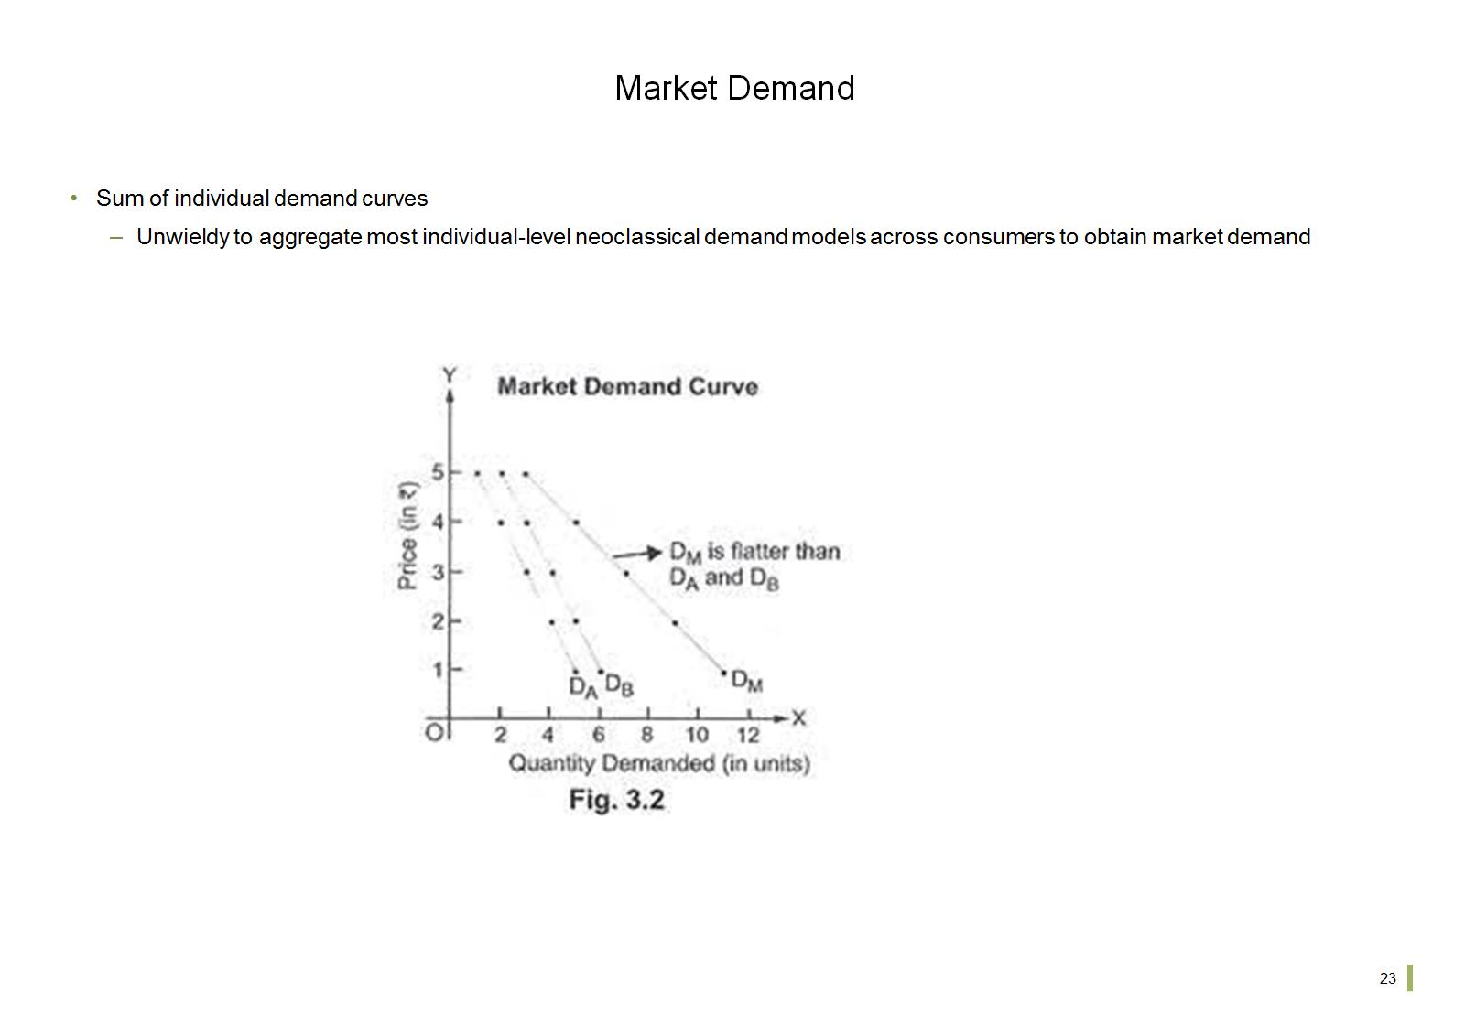
Market Demand

Slide 25
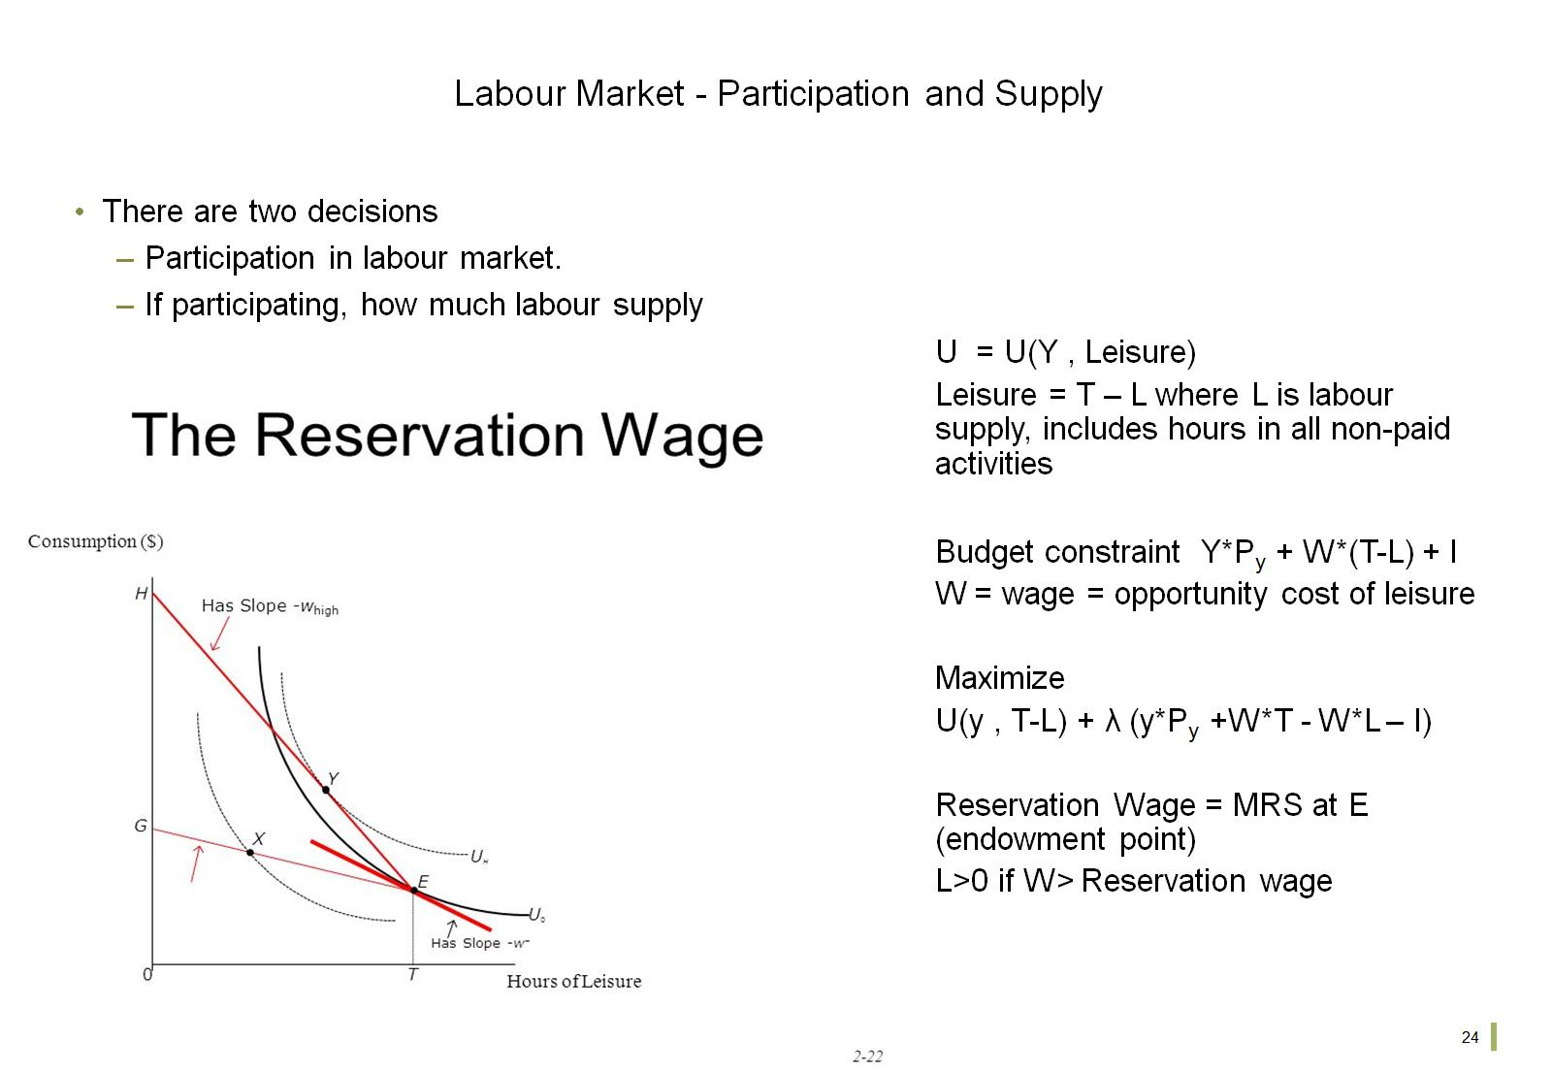
Labour Market - Participation and Supply

Slide 26
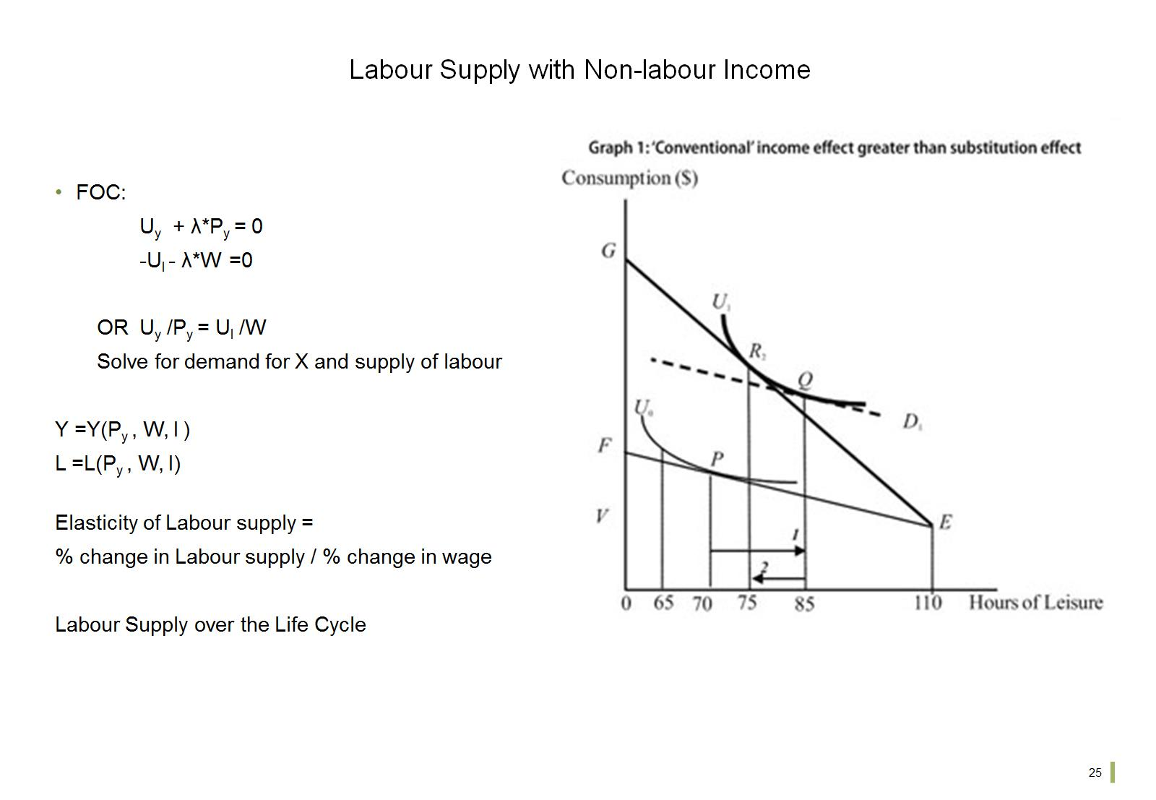
Labour Supply with Non-labour Income

Slide 27
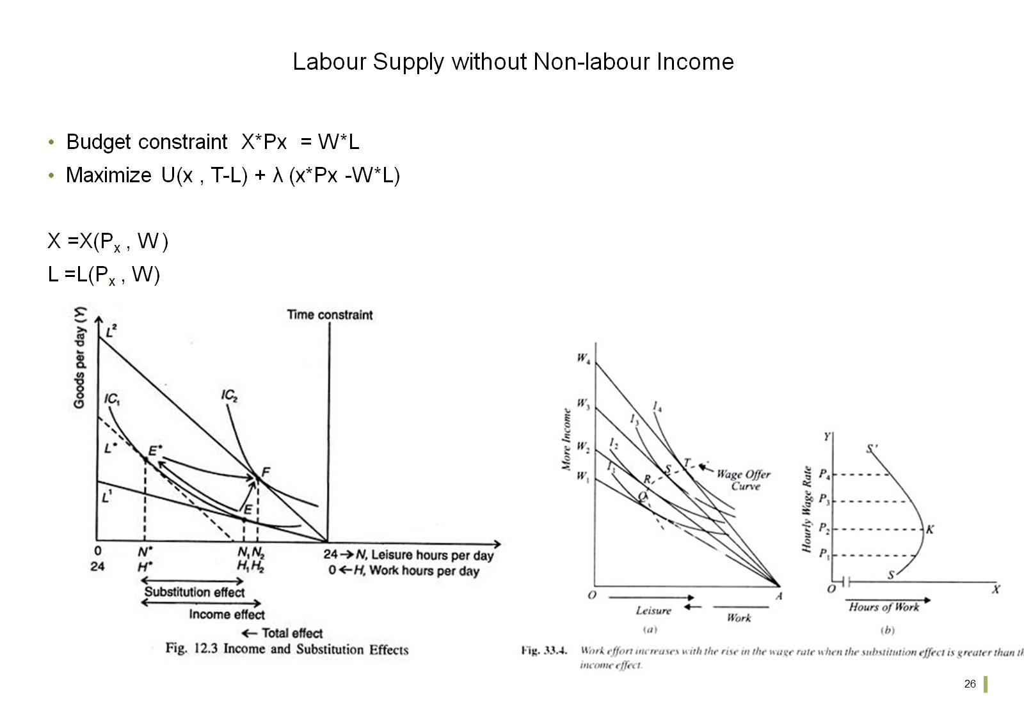
Labour Supply without Non-labour Income

